Slide 1
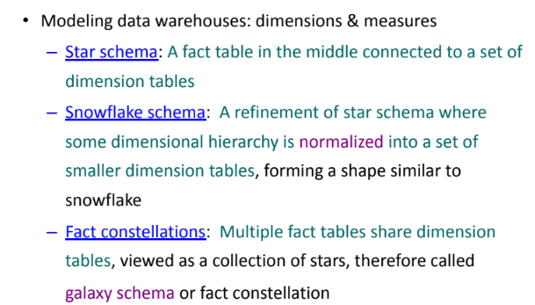
Modeling a Datawarehouse

Slide 2
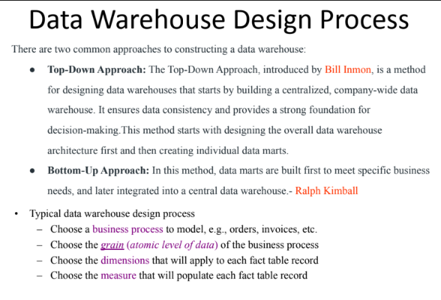

Slide 3
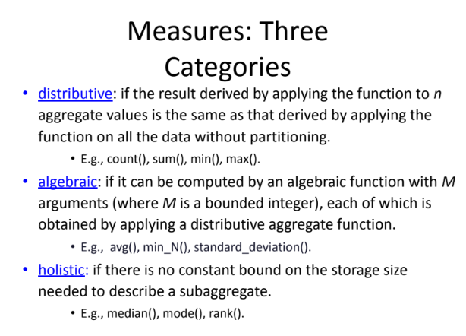

Slide 4
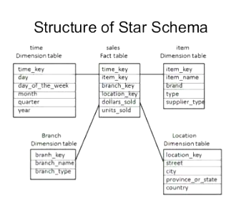

Slide 5
Snowflake Schema
Snowflake schema is a type of star schema but a more complex model.
“Snowflaking” is a method of normalizing the dimension tables in a star schema.
The normalization eliminates redundancy.
The result is more complex queries and reduced query performance.
Advantages:
Small saving in storage space
Normalized structures are easier to update and maintain
Disadvantages:
Schema less intuitive and end-users are put off by the complexity
Ability to browse through the contents difficult
Degrade query performance because of additional joins
CSE601
‹#›
Notes:
‹#›

Slide 6
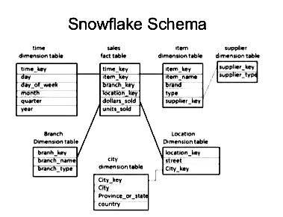

Slide 7
What is the Best Design?
Performance benchmarking can be used to determine what is the best design.
Snowflake schema: easier to maintain dimension tables when dimension tables are very large (reduce overall space). It is not generally recommended in a data warehouse environment.
Star schema: more effective for data cube browsing (less joins): can affect performance.
CSE601
‹#›
Notes:
‹#›

Slide 8
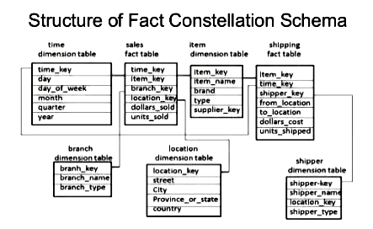

Slide 9
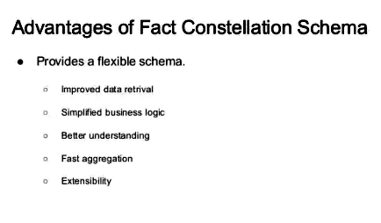

Slide 10
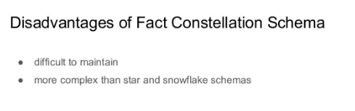

Slide 11
What is the total dollar sales and the total dollar costs of all candy sold in supermarket stores on Saturdays?
time_key SQL_date day_of_week month fiscal_period season
Product Dimension
product_key SKU description brand category department package_type size … etc.
Sales Fact Table
time_key product_key store_key promotion_key dollars_sold units_sold dollars_cost
Time Dimension
Store Dimension
store_key store_ID store_name address region division floor_plan_type
Promotion Dimension
promotion_key promotion_name price_type ad_type display_type … etc.

Slide 12
What is the total dollar sales and the total dollar costs of all candy sold in supermarket stores on Saturdays?
SELECT p.category, sum(f.dollar_sales), sum(f.dollar.cost) FROM sales_fact f, product p, time t, store s
WHERE f.product_key = p.product_key
and f.time_key = t.time_key and f.store_key = s.store_key
and p.category = ‘Candy’
and t.day_of_week = ‘Saturday’ and s.floor_plan_type = ‘Super_Market” GROUP BY p.category

Slide 13
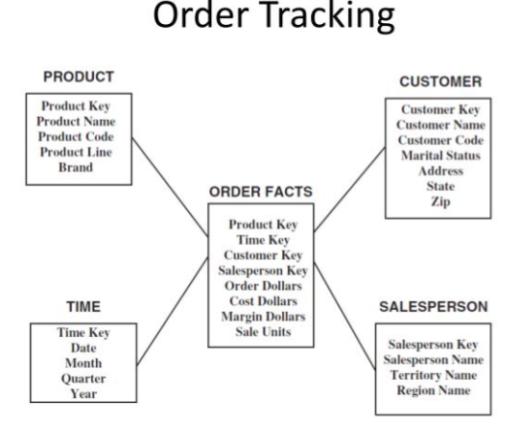

Slide 14
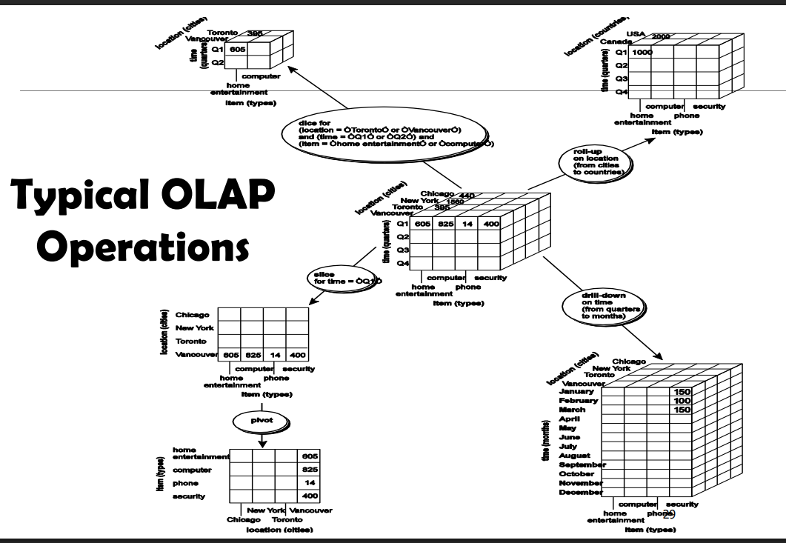

Slide 15
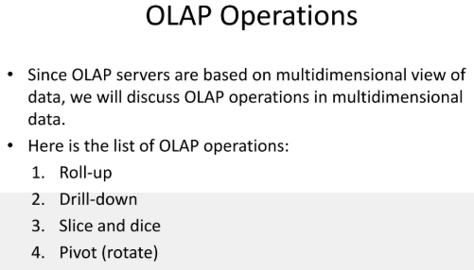

Slide 16
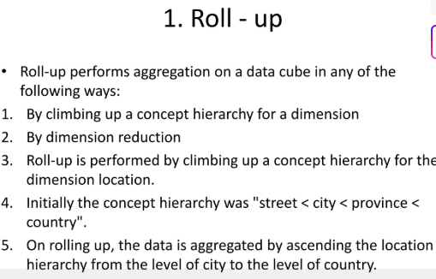
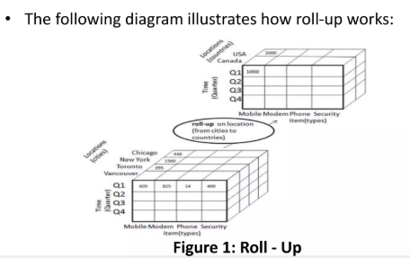

Slide 17
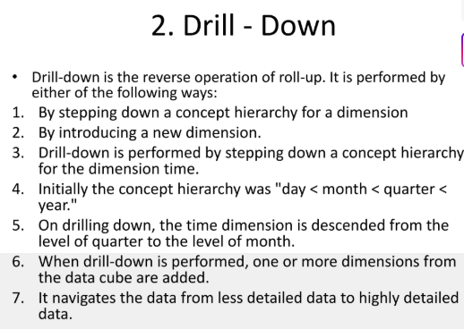
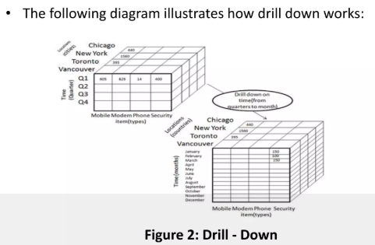

Slide 18
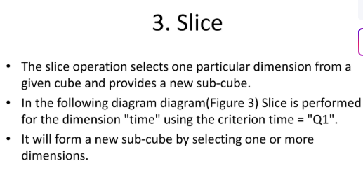
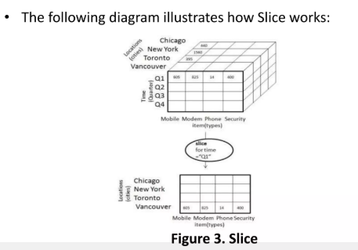

Slide 19
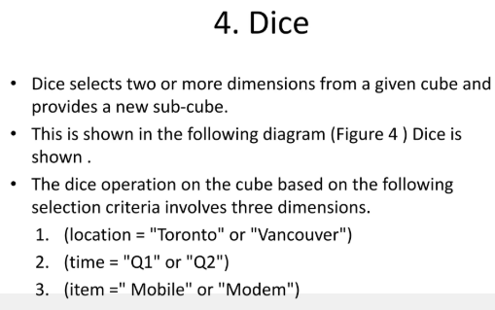
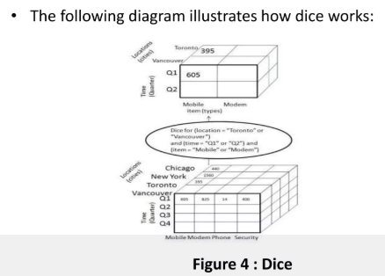

Slide 20
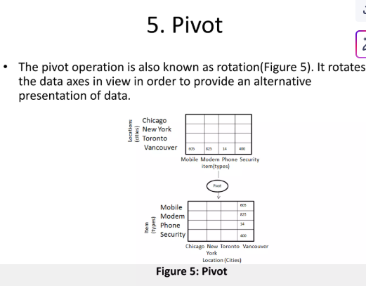

Slide 21
Updating
Over time, what happens to the fact table?
Every day as more and more sales take place, more and more rows get added to the fact table. The fact table continues to grow in the number of rows over time.
Very rarely are the rows in a fact table updated with changes.
Even when there are adjustments to the prior numbers, these are also processed as additional adjustment rows and added to the fact table.
Updating Dimension table
Compared to the fact table, the dimension tables are more stable and less volatile.
However, unlike the fact table, which changes through the increase in the number of rows, a dimension table does not change just through the increase in the number of rows,
Dimension table makes changes to the attributes themselves.

Slide 22
Slowly changing dimensions
Most dimensions are generally constant over time
Many dimensions change slowly
Though the key does not change other description and attributes change slowly over time
Dimension table attributes are not overwritten
The ways changes are made in dimension tables depend on the types of changes and what information must be preserved.

Slide 23

Type 1: Correction of errors
Usually relate to correction of errors in the source systems.
E.g., spelling error in customer names; change of City customers;
There is no need to preserve the old values here.
Overwrite attribute value in the dimension table row with new value.
The key is not disturbed
Easiest type of change to implement.
change in address

Slide 24

Type 2: preservation of history
True changes in the source systems.
E.g., change of marital status; change of address
There is a need to preserve history
Every change for the same attribute must be preserved.
Applying these changes:
Add a new dimension table row with new value of the changed attribute
No changes are made to the existing row.
New rows are inserted with a new surrogate key.

Slide 25

Type 3: tentative soft revision
Tentative changes in the source system
E.g., if an employee will get posted for a short period to a different location
Need to keep track of history with old and new values
Used to compare performances across the transition
Applying these changes
An “old” field is added in the dimension table
Push existing value of attribute from “current” to “old”
Update the “current” field with the new value with effective date

Slide 26

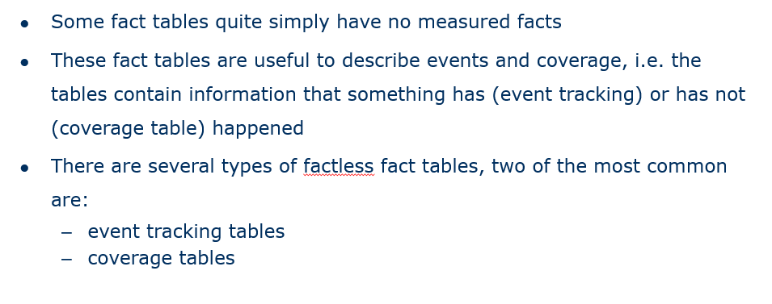

Slide 27
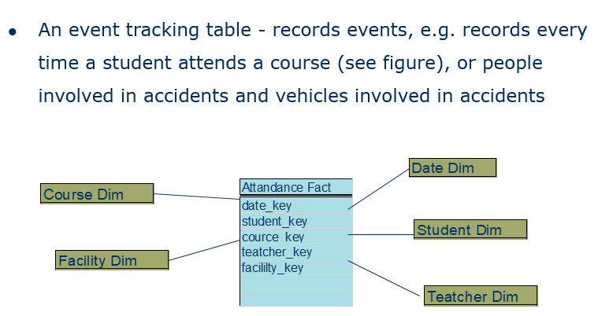

Slide 28
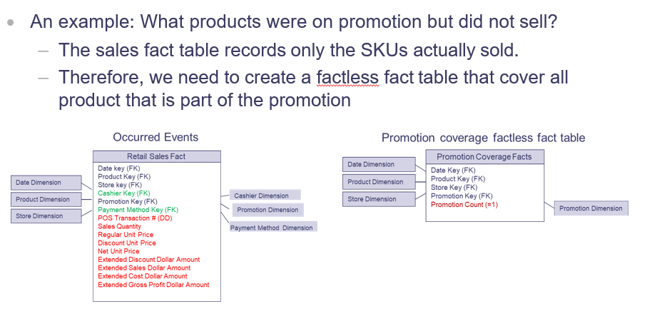
Coverage Table

Slide 29
Large dimensions
Very deep(large number of rows)
Very wide(large number of attributes)
Have multiple hierarchies
Rapidly changing dimensions
Junk dimensions
Degenerate Dimensions
Large dimension examples
Customer
Huge—in the range of 20 million rows
Easily up to 150 dimension attributes
Can have multiple hierarchies
Product
Sometimes as many as 100,000 product variations
Can have more than 100 dimension attributes
Can have multiple hierarchies

Slide 30

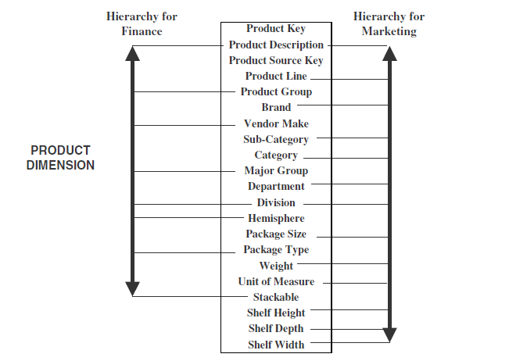

Slide 31

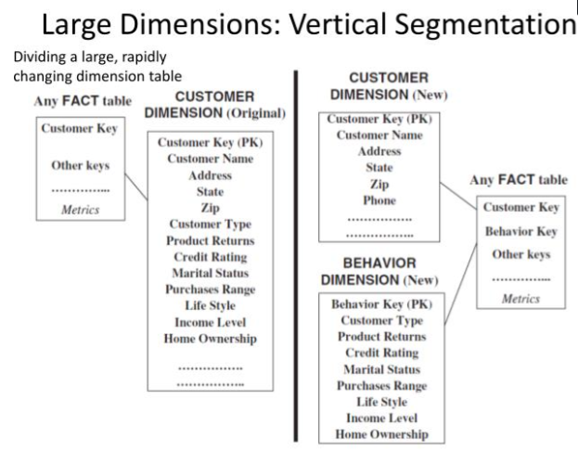

Slide 32
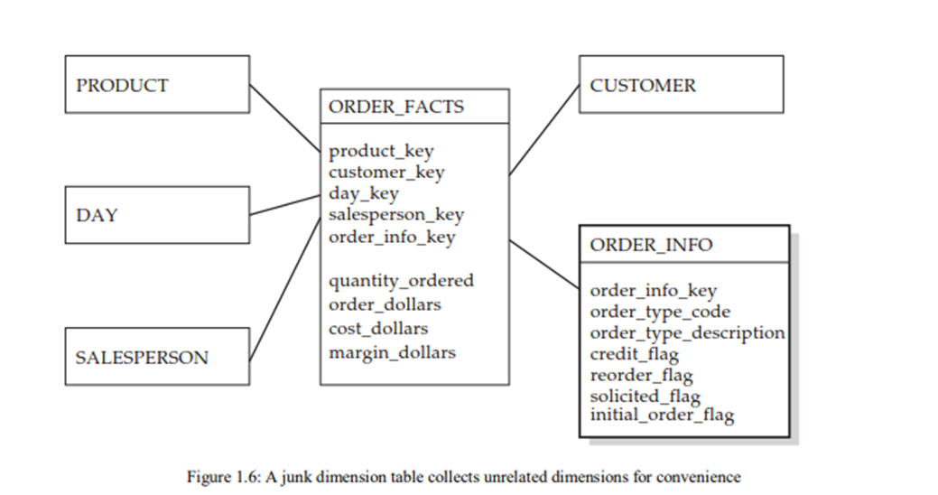
Junk Dimensions
In some cases, it can be useful to create a table that contains dimensions that do not have any real relationship to one another. The orders schema shown in Figure 1.6, for example, might benefit from the addition of several attributes to describe the type of order being placed, whether it was a credit order, whether it was solicited, and whether it represents a reorder. While these various indicators do not relate directly to one another, they can be combined into a single table for convenience

Slide 33
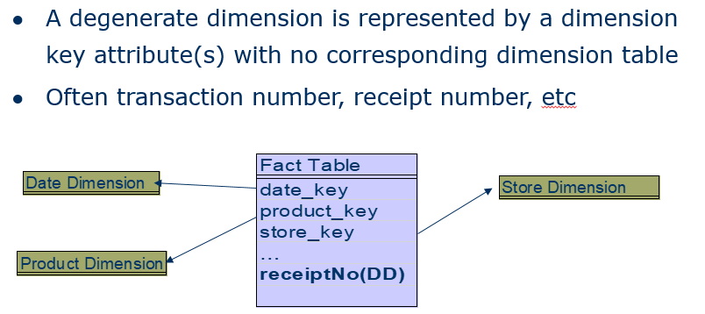
Degenerate Dimension

